Slide 1

Note: The data and information in this document is reflective of a hypothetical situation and client. This document is to be used for KPMG Virtual Internship purposes only.
Sprocket Central Pty Ltd
Data analytics approach
Le Tran Ai Sa

Slide 2
Introduction
Introduction
Overview
Revenue by product
Revenue by customer

Slide 3
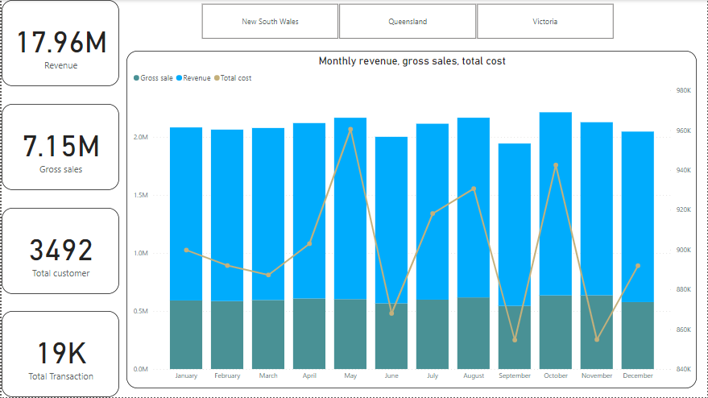
Overview
Revenue and Gross sales over the months are almost equal while the costs have a clear difference between the months.

Slide 4
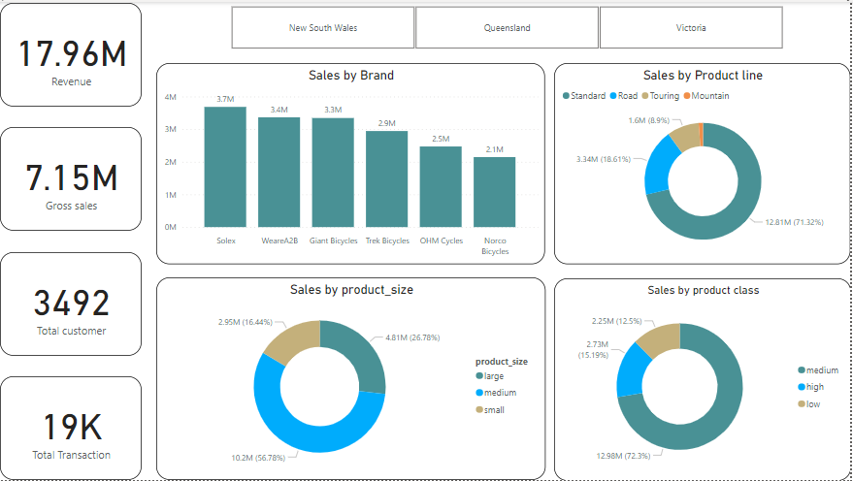
Revenue by product
Solex, WearA2B, Giant Bicycles are the top 3 favorite brands.
The most popular product line is Standard.
The intermediate class is the most consumed.
The most consumed product size is medium.

Slide 5
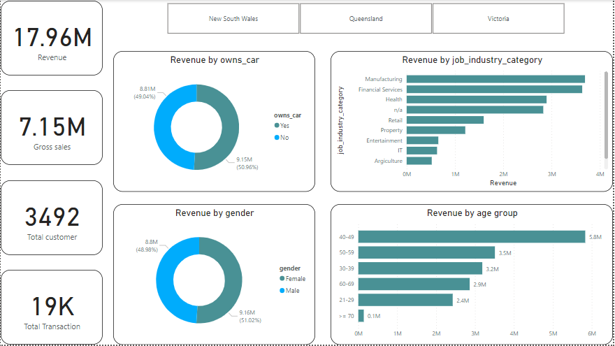
Revenue by customer
Revenue is not significantly dependent on gender or owning a personal car.
Target customers are those in the Manufacturing, Financial Services and Health groups.
By age, the age group from 40-49 accounts for the majority.

Slide 6
Propose
It is necessary to control costs more closely, reducing the monthly work, the costs increase too high and the monthly is too low while the profit does not increase significantly.
Focusing on investing in products from Solex, WearA2B and Giant Bicycles brands, focusing on standard, medium and medium-sized models.
Looking for customers with job industry category under Manufacturing, Financial Services and Health groups.
The target group of customers to focus on is the age group of 40-49.

Slide 7
Thank you!

